Slide 1
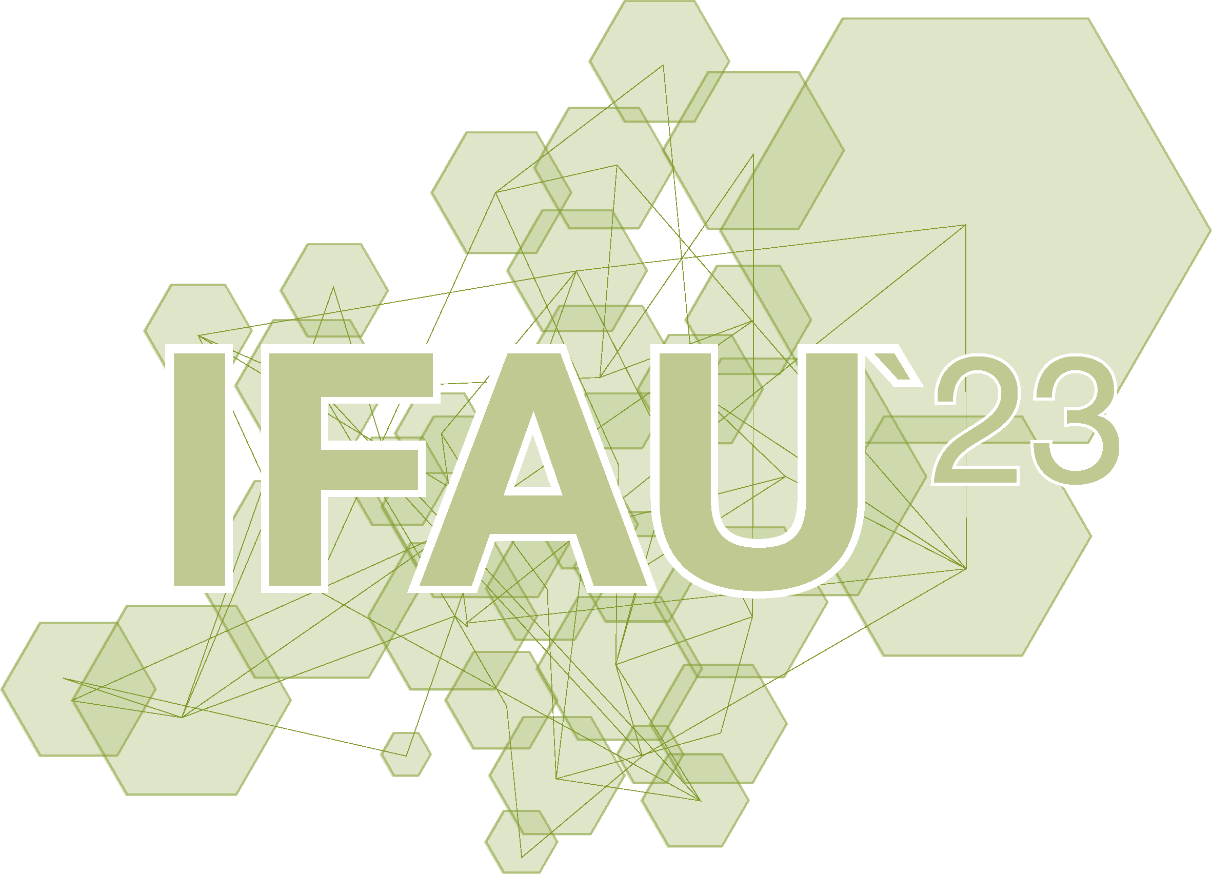

TRAFFIC NOISE MITIGATION IN URBAN MULTISENSORY ENVIRONMENTS: A VIRTUAL REALITY APPROACH TO URBAN SOUND PLANNING
Jian Li
Università degli studi della Campania ‘’Luigi Vanvitelli’’
IV INTERNATIONAL FORUM ON ARCHITECTURE AND URBANISM
CLIMATE CHANGE AND CULTURAL HERITAGE
22 - 23 JUNE 2023 | CASERTA

Slide 2


Introduction
City dwellers are typically surrounded by a multitude of activities due to the densification of urban areas.
This has led to the multiplication of noise sources that people are exposed to in their daily lives.
Road traffic is one of the main threats to human well-being in cities.
Studies highlighted various adverse impacts of noise exposure on well-being and health, such as sleep disturbance (Muzet, 2007), annoyance (Miedema, 2001), and hypertension (Petri, 2021).
Jian Li
Traffic Noise Mitigation in Urban Multisensory Environments: a Virtual Reality Approach to Urban Sound Planning

Slide 3
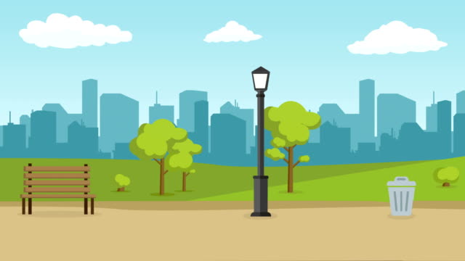
Introduction
Natural element, both visual (e.g., the presence of plants, trees, or water) or auditory (e.g., bird song, water sound, tree leaves rustling in the wind), are known to affect peoples’ well-being and capabilities to restore cognitive resources (Franco, 2017).
Annoying auditory experiences due to traffic noise in urban areas were judged less annoying when combined with a natural visual context than with an urban scene (Viollon, 2002).
The use of informational sound masking with water sounds was considered less restorative if congruent visual element were not well recognized (Masullo, 2021b).
Jian Li
Traffic Noise Mitigation in Urban Multisensory Environments: a Virtual Reality Approach to Urban Sound Planning

Slide 4
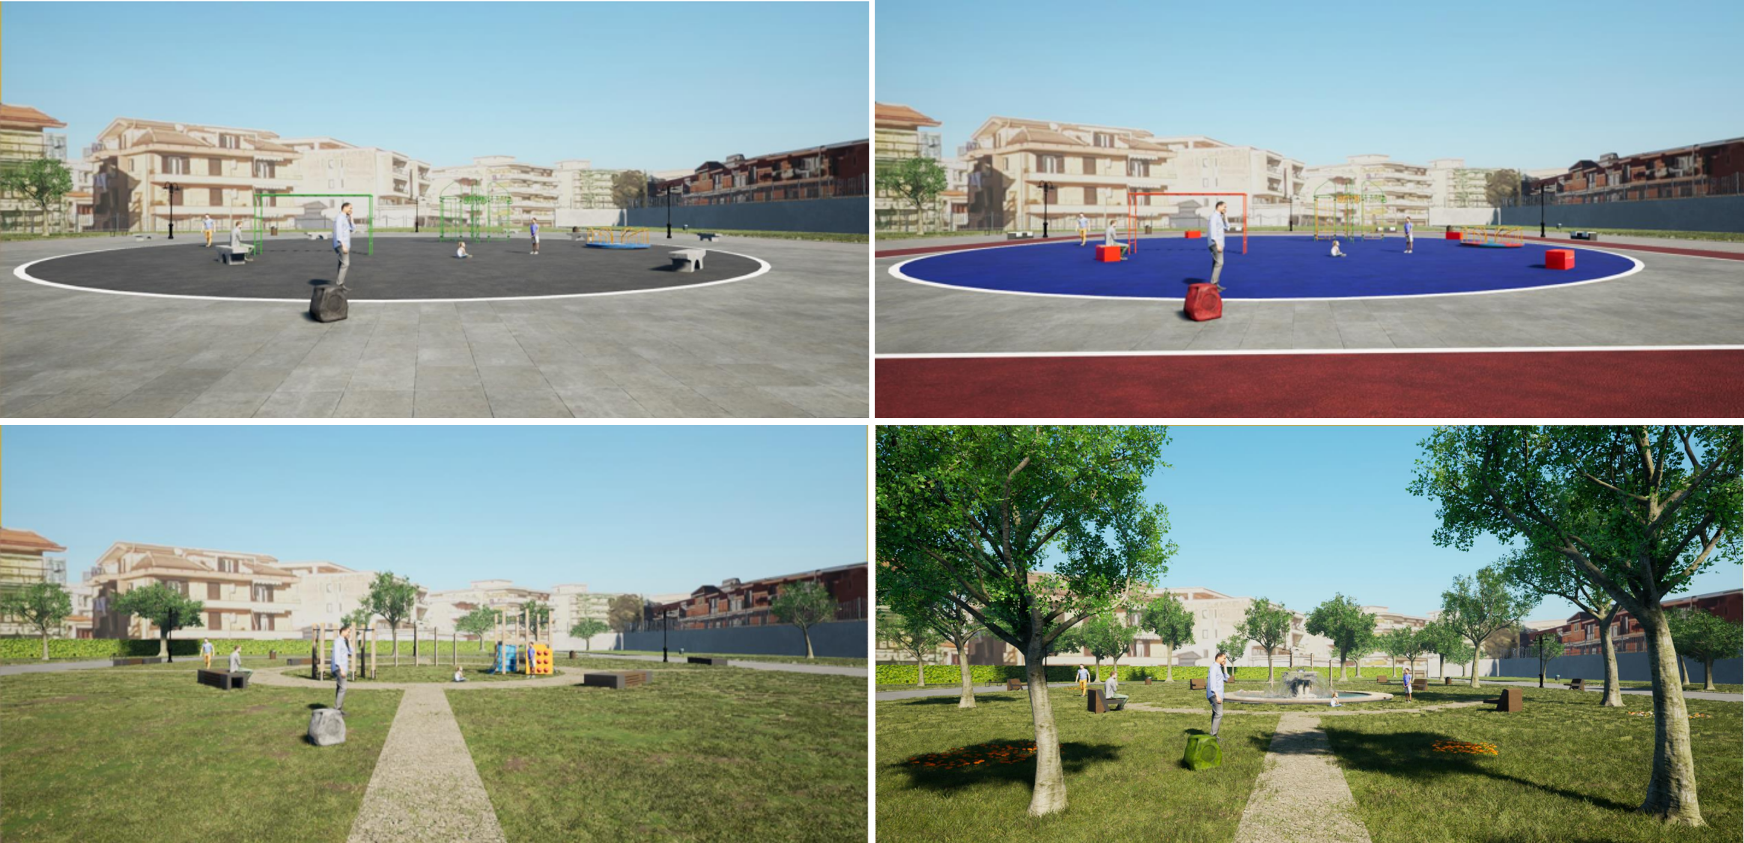
Research Design
The present study aims at identifying how auditory and visual aspects influence each other and how their combination modulates the negative effect caused by road traffic noise. To this aim, four visual and audio stimuli were combined:
1 Visual stimuli
Concrete :
characterized by concrete elements and very little green spots.
Coloured Concrete:
characterized by more vivid concrete but also very green.
Green-1:
presence of vegetation and natural elements. Furthermore, the design of the décor is modern and mainly recalls natural elements (both with colours and materials).
Green-2:
richer vegetation and central square characterized by a fountain (water present only when combined with water audio).
Jian Li
Traffic Noise Mitigation in Urban Multisensory Environments: a Virtual Reality Approach to Urban Sound Planning

Slide 5
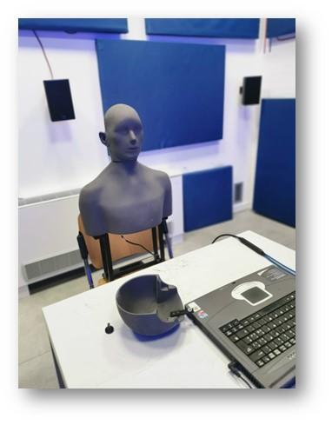

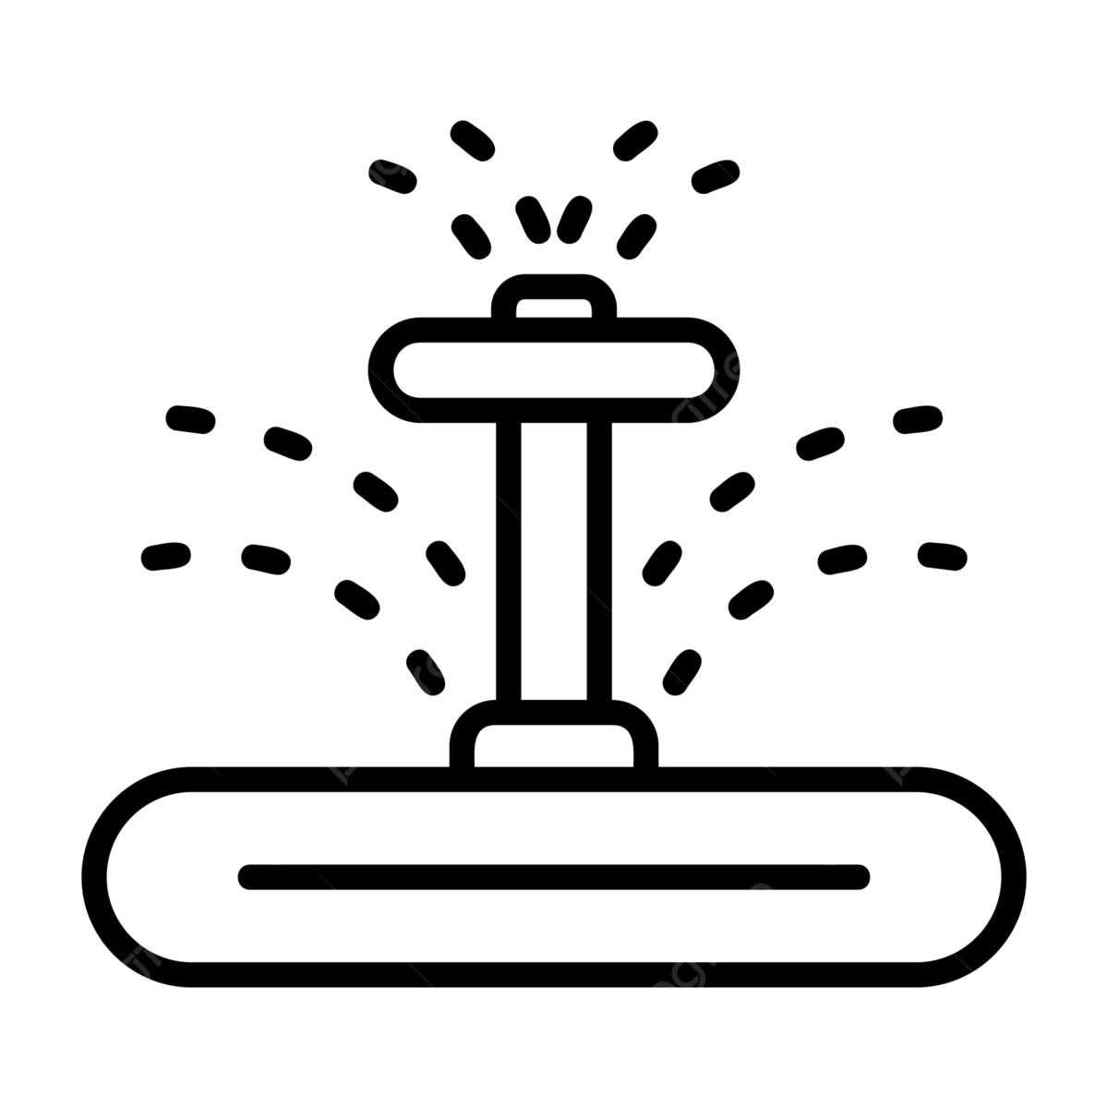



Research Design
2 Auditory stimuli
Five auditory stimuli were considered: water, people chattering, birds chirping, piano music and vehicular traffic sound (the latter present in all conditions). All the sounds of the scenarios were calibrated with the MK1 Cortex Manikin and calibrated at 45dBA (35 dBA for vehicular traffic).
Audio stimuli
Jian Li
Traffic Noise Mitigation in Urban Multisensory Environments: a Virtual Reality Approach to Urban Sound Planning

Slide 6
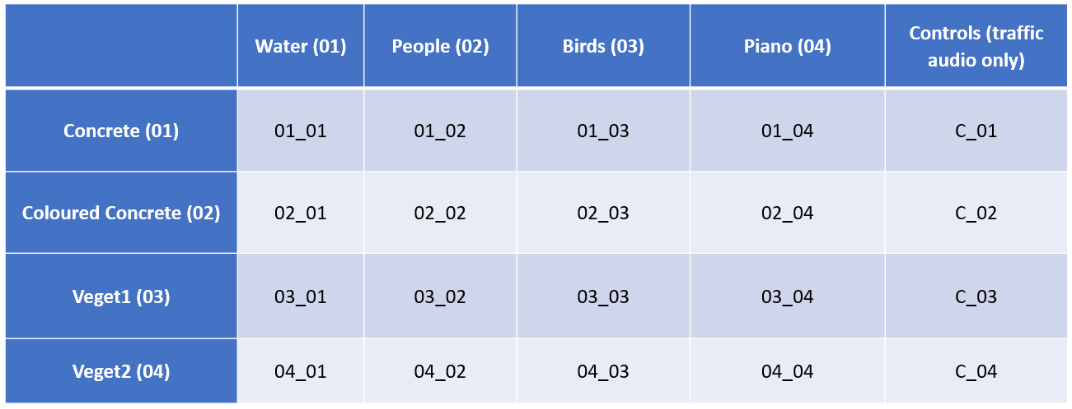
Research Design
3 Method
First, participants completed the Multidimensional Assessment of Interoceptive Awareness (MAIA), the Weinstein Noise Sensitivity Scale (WNSS) and the Positive and Negative Affect Schedule (PANAS) to verify whether they have a role in the perception of the audio-visual multisensory scenarios. After the questionnaires, they wore the HTC Vive Pro for the virtual scenarios.
The experimental design includes a total of 20 scenarios resulted from the combination of:
Five audio tracks;
Four visual stimuli
Four control scenarios with only traffic sound.
Jian Li
Traffic Noise Mitigation in Urban Multisensory Environments: a Virtual Reality Approach to Urban Sound Planning

Slide 7
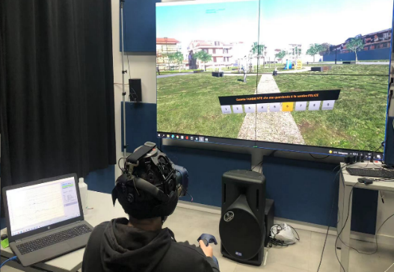
Research Design
4 Procedure
The study was conducted in the test room of the Sens i-Lab, the human-centred, multi-physical and multi-purpose laboratory of the Department of Architecture and Industrial Design of the University of Campania “Luigi Vanvitelli” administering virtually simulated environments and by measuring the individuals’ preferences through an affective evaluation scale.
The study involved 30 participants (22 M; 8 F) aged between 18 and 48 years (M = 27.3; SD = 7.6).
In the present study, participants were asked to rate how Pleasant, Attractive and Stimulating each scenario was and how Calm, Happy and Energetic it made them feel. Furthermore, the questionnaire was implemented in an interactive version.
Participants wait one minute before an interactive questionnaire is enabled in front of them. Once all 6 adjectives from the questionnaire have been answered, they move on to the next scenario.
Jian Li
Traffic Noise Mitigation in Urban Multisensory Environments: a Virtual Reality Approach to Urban Sound Planning

Slide 8
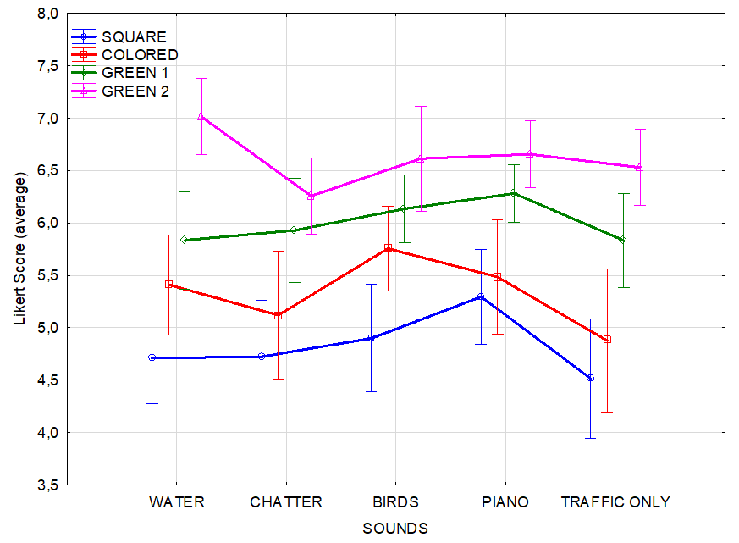
Results
An ANOVA for repeated measures was used to test whether sound type influenced the perception of the four types of parks.
Consistently with literature, the scenarios were judged less negative when a natural visual context was present and both the Green scenarios were those rated higher (Rapuano, 2022).
Also, sounds influenced scenarios perception:
Birds sound to the Colored Concrete scenario significantly improved judgements.
Colored Concrete with Birds sound rated as high as the Green 1 scenario.
Piano sound improved the judgements of the Concrete scenario when compared to the control condition (only traffic sound).
Water positively affected ratings especially when it was associated with a congruent visual element (i.e., the presence of the fountain).
Average score for each virtual scenario according to different sounds.
Jian Li
Traffic Noise Mitigation in Urban Multisensory Environments: a Virtual Reality Approach to Urban Sound Planning

Slide 9
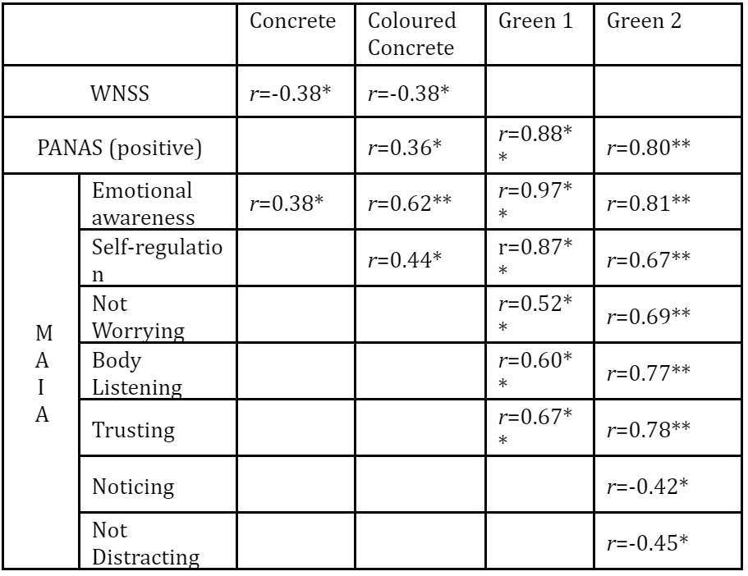
Results
Furthermore, to find out whether participants' mood, interoceptive awareness, and sensitivity to noise were associated with judgments of the different virtual scenarios, a correlational analysis was carried out.
Overall, positive associations were found between mood and park judgements and between how much one’s focused on their feelings and sensations.
Correlation between Salience of Stimuli Questionnaire with WNNS, PANAS (positive) and MAIA dimensions for each park category (* p< 0.05; ** p< 0.001).
Jian Li
Traffic Noise Mitigation in Urban Multisensory Environments: a Virtual Reality Approach to Urban Sound Planning

Slide 10
Conclusions
The results of the current study suggest that natural aspects can improve people’s judgements of potential urban spaces used for their leisure time.
Natural elements (both visual and auditory) can be important factors in isolating relaxing spaces from road traffic noise.
Interestingly, not only natural elements but also anthropic sound can intervene in enhancing environments. The Concrete Park was rated significantly better when combined with Piano music. This indicates that special attention should be paid to the acoustic aspect of environments where the addition of green elements is limited.
Finally, the congruence found in the correlation between participants' feelings and ratings supports the idea that a human-centric approach that considers emotional factors is fundamental when assessing how people perceive audio-visual stimuli.
Jian Li
Traffic Noise Mitigation in Urban Multisensory Environments: a Virtual Reality Approach to Urban Sound Planning

Slide 11
THANK YOU!
Jian Li
Traffic Noise Mitigation in Urban Multisensory Environments: a Virtual Reality Approach to Urban Sound Planning

